Slide 1
AI-POWERED TARGET RECOGNITION SYSTEM
Weaponizers
S SUJAN RA2311003020537

Slide 2
Weaponizers
Problem Statement and Motivation
PROBLEM STATEMENT:
General-purpose YOLO models lack precision in identifying weapons like guns or knives.
False positives and missed detections pose a risk in critical security applications.
High dependency on powerful hardware for real-time processing, limiting portability.

Slide 3
Weaponizers
Problem Statement and Motivation
MOTIVATION:
Provides real-time weapon detection to prevent dangerous situations and protect lives in high-risk areas such as airports, schools, and malls.
Reduces reliance on manual monitoring, minimizes human error, and ensures 24/7 vigilance using AI-driven automation.

Slide 4
Weaponizers
Methodology and Approach
METHODOLOGY:
Data Collection and Preprocessing: Gather and preprocess a dataset of weapon images, including normal and thermal data.
Model Development: Fine-tune the YOLO model for high accuracy in weapon detection.
System Integration: Integrate motion detection, live video annotation, and thermal toggling capabilities.
Testing and Validation: Test the system in various scenarios to ensure reliability and accuracy.
Deployment: Deploy the system on standard PC platforms.

Slide 5
Weaponizers
Methodology and Approach
APPROACH:
We Choose and fine-tune a pre-trained object detection model (YOLO) to identify weapons accurately and efficiently.
Implemented a real-time video feed analysis using OpenCV and GPU acceleration (NVIDIA CUDA) to ensure the system can detect threats without lag.
Develops an alert system that triggers notifications, pop-ups, and saves detected frames when weapons or suspicious activities are identified.

Slide 6
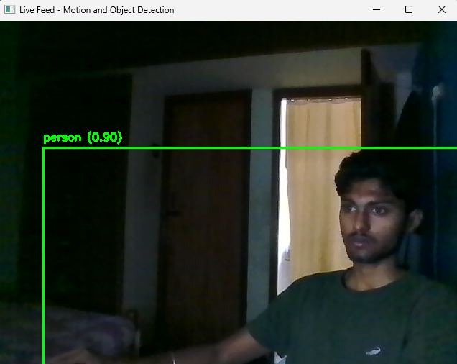
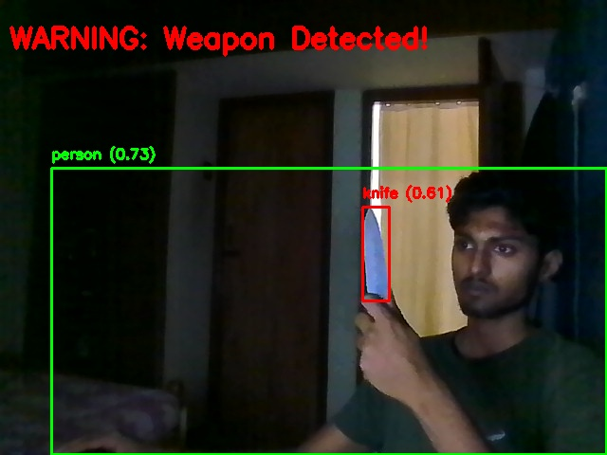
Weaponizers
Results and Achievements

Slide 7
Weaponizers
Future Work and Conclusion
FUTURE WORK:
We have a plan to Deploy the system on drones for mobile surveillance in outdoor areas like borders, public events, or disaster zones, with real-time GPS tracking.
By Integrate thermal imaging and other sensors like LIDAR or RADAR for improved performance in low-light or challenging environments.
Continue refining the detection model by training with larger and more diverse datasets to reduce false positives and negatives.

Slide 8
Weaponizers
Future Work and Conclusion
CONCLUSION:
Addressing the limitations of existing systems through specialized training and optimization.
Pioneering a robust solution for real-time security applications.
A reliable, real-time weapon detection system can redefine security standards and save lives in critical situations.

